Slide 1
Incompleteness and Resilience A presentation for the XXVIII Colloquium of the IACST
Marc Surchat
29. August 2014

Slide 2
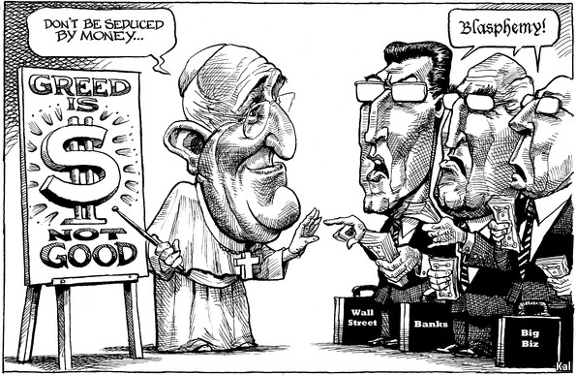
Introduction

Slide 3
Gödel incompleteness theorem
Existence theorem: if a system is logical, it has at least one auto-referential argument.
Valid for all sciences, also all theological arguments, all human beings, all human organisations, all political system, aso…, whatever the size of the system.
It is often the “original sin” of those systems.
Completeness for humans: Beauty, love, faith, trust, justice, creativity, empathy, hope, aso…, so always beyond the existing logical system.
This theorem has a wildly unutilized potential.
In economics: Homo oeconomicus and well-functioning complete markets. In fact the search for profits leads to thinking in only one way.

Slide 4
Incompleteness and economics
Markets can not be complete, ever.
Sometimes markets can be completed: new instruments and high-quality financial institutions, in particular the powerful central banks.
Emergence of the risk society of Ulrich Beck, but also the technological bluff of Jacques Ellul.
Economic agents are themselves incomplete and even irrational. Moral hazard and adverse selection are common.
Not everything can be exchanged on markets
Paul Dembinski: the unquantifiable and altruism

Slide 5
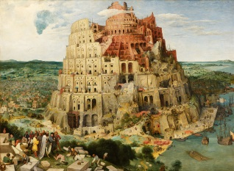
Incompleteness and financial crisis
The first financial crisis: the Babel tower (gen. 11)

Slide 6
Incompleteness and financial crisis
The first historically recorded financial crisis in 1343: the default of Edward III of England
800 years of financial follies later, always with the certainty that “This time is different”:
The subprime crisis in 2008
The European debt crisis in 2010
The structure of all financial crisis:

Slide 7
Incompleteness and financial crisis
Incomplete markets, especially for quality and new risks
And so unmanaged risks
Financial and economic multiplicator
Innovations in a wide sense
Incomplete measures of quality, so of risks
Not resilient society and/or economy

Slide 8
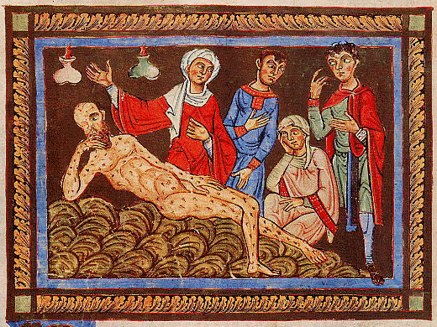
Resilience as a response to Job
The Book of Job was written during the captivity in Babylone

Slide 9
Resilience as a response to Job
Instability is unavoidable in human evolution
Respect of the law is not going to save us
Globalization neither
But the high-quality of institutions might and should help us :
Preventing crisis
Extending Knowledge
Reallocating property rights and incentives quickly
Easing the adaptation process
Learning the true lessons of a crisis and creating new institutions

Slide 10
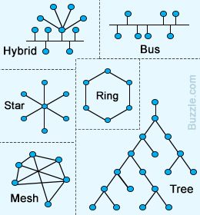
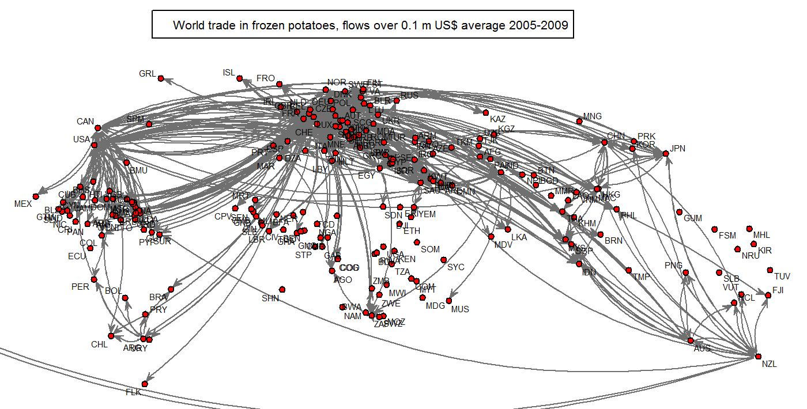
Institutions and incompleteness
Institutions: Markets, Hierarchies, Networks, but many Social & Political Institutions are auto-referential
The real world:

Slide 11
Institutions and incompleteness
Social & Political Institutions are often arbitrary (Arrow theorem), when they go beyond bilateral relations (at least 3 persons involved).
They are favourable to human development when they have a bias toward openness,
They give coherence, “meaning” and incentives to humans for searching their completeness (which is possible only in God with the Holy Spirit) sometimes by taking risks
They are very diversified and extended today (politics, aso…). The most important is the family.

Slide 12
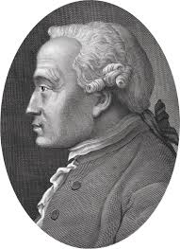
Institutions and incompleteness
Homo Kantensis as the only socially stable alternative to the Homo Oeconomicus. The Homo Kantensis requires high-quality Institutions in order to exist.

Slide 13
Institutions and social problems
Building and expliciting trust with high-quality institutions in an unstable risky world for dealing with:
Poverty, violence and corruption
Technological progress
Labour relations
Ideological oppression
Instability and non-sustainability
Dialog between Civilisations, aso
In fact well-designed institutions create qualitative growth by reducing new risks, but their emergence is very complex and details are important.

Slide 14
Conclusions
The consciousness of its own incompleteness is unique to mankind
Completing our society is an on-going endeavour
It requires sometimes (often) a crisis
A resilient society has high-quality institutions that support trust in incomplete situations, including in a crisis
Christ has given us the central guidelines for building high-quality institutions
The modern world needs those guidelines more than ever in face of technological progress, risk management, Big Brother and in a bipolar world.
This is an opportunity for the catholic Church

